Slide 1
MANAGE SUCCESSFUL FIELD RESEARCH 2024

Slide 2
Stata: Data Cleaning & Tidying
Ankriti Singh
Research Consultant

Slide 3
Outline
Data cleaning
Unique ID
Cleaning different data types
Identity outliers
Tidy data
Merge
Aggregating data
iecodebook

Slide 4
Overview: Stata Labs
Introduction to Stata
Data Cleaning & Tidying
Descriptive Analysis with tables
Descriptive Analysis with graphs

Slide 5
Today’s lab
Introduction to Stata
Data Cleaning & Tidying
Descriptive Analysis with tables
Descriptive Analysis with graphs

Slide 6
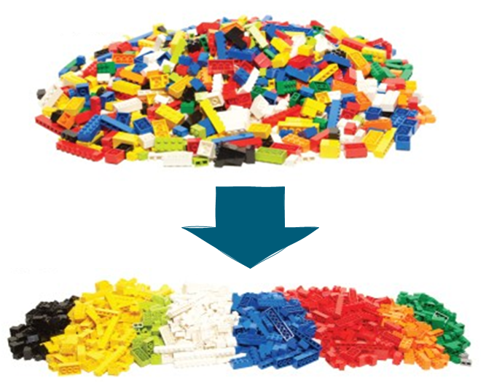
What is Data Cleaning?

Slide 7
What is Data Cleaning?
Cleaning is about changing the format of the data to the format that is the most efficient to store and handle in statistical software and the easiest for humans to understand
We are not making changes to the information contained in the dataset – this will come later, in data construction

Slide 8
Setting the stage
Launch Stata
Open lab2.do
Load the dataset TZA_CCT_baseline.dta

Slide 9
Unit of observation & Unique IDs

Slide 10
Where should we start?
The first thing you want to look for every single time you open a new dataset is:
1. Unit of observation: the object or unit that is being described in the data set
2. Uniquely and fully identifying ID variable: the column in the data set that can be used to tell one observation apart from the others
- Uniquely identifying cannot have duplicated values
- Fully identifying cannot be missing

Slide 11
Unique ID
Why is it so important to have a unique identifier for our unit of observation?
To ensure that we are not giving more weight to one observation unit than others (if that observation is duplicated)
To use it to combine datasets (more on this later in the course)

Slide 12
Task 1: Identify Unique ID
browse the dataset and try to identify its unit of observation and ID variable
Commands for testing that a variable is uniquely and fully identifying:
isid
unique
Check the help files for these commands to see how they can be used

Slide 13
Task 1: Identify Unique ID
Use isid to test whether the variable hhid uniquely identifies the observations in this dataset
Does it uniquely identify the dataset?

Slide 14
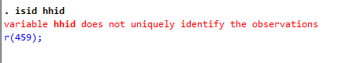
Task 1: Identify Unique ID
Use isid to test whether the variable hhid uniquely identifies the observations in this dataset
Does it uniquely identify the dataset?

Slide 15
Solving duplicates with ieduplciates
ieduplicates is a command from the package iefieldkit
Used to identify duplicates in ID variable and export them in an Excel file that also can be used to correct the duplicates.

Slide 16
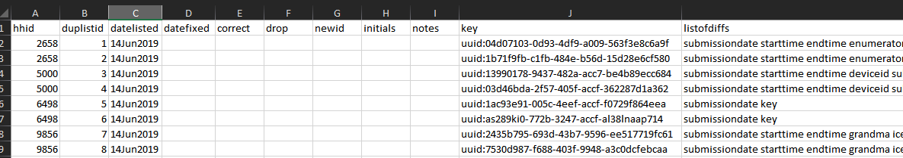
ieduplicates
ieduplicates idvarname ///
using "/path/to/duplicates/report.xlsx", ///
uniquevars(varlist)
It will export an Excel file like:

Slide 17
Task 2: Identify & duplicates
Use ieduplicates command to report the duplicates observations
Check the help file for the command to see how to is implemented
Install the package iefieldkit if has not been installed already
ssc install iefieldkit, replace
Edit the Excel file to keep the unique ids
Save the Excel file
Run the command again
Use isid to test whether the variable hhid uniquely identifies the observations in this dataset

Slide 18
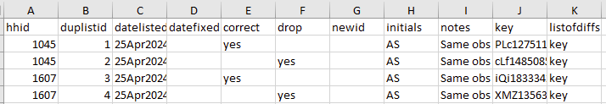
Identify & fix duplicates
ieduplicates hhid ///
using “${project}/report.xlsx", ///
uniquevars(key)

Slide 19
Cleaning string variables

Slide 20
Common issues with text fields
Text fields in our survey (string variables in Stata) can have typos that need to be cleaned. Some of them include:
Incorrect spellings or incomplete words
Extra spaces (trailing or in between words)
Different cases (uppercase or lowercase)
Special characters (.?!)
Humans can tell the meaning of a word regardless of which letters are capitalized or not, of how spaces are used, and even if they are mistyped, but Stata is not that smart
It may be hard for the human eye to see one extra space, but not for Stata

Slide 21
Cleaning string variables
What are different ways to identify the string variables in our data set?
codebook
describe
ds, has(type string)
Variables and Properties windows
Browsing the dataset

Slide 22
Cleaning string variables in Stata
Commands in Stata to clean string variables:
replace: to replace the contents of the existing variable
replace oldvar =exp [if] [in]
Can be used for other types of variables too

Slide 23
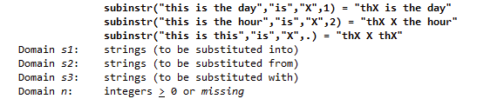
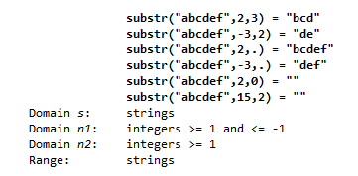
Cleaning string variables in Stata
Functions in Stata to clean string variables:
upper(s): capitalize all characters in string s
lower(s): make all characters in string s lower case
proper(s): capitalize only the first letter of each word in string s
strtrim(s): removes leading and trailing spaces
substr(s, n1, n2): the substring of s, starting at n1, for a length of n2
subinstr(1, s2, s3, n) :s1, where the first n occurrences in s1 of s2 have been replaced with s3
Note these are functions, not commands: Functions cannot be used by themselves, but rather need to be used inside a command. To see the help file for functions we need to add parentheses after their names: help proper()

Slide 24
Task 3: Clean string variables
Use tabulate to explore the string variable crop_other
How can you clean this variable?
Use replace with proper() function to fix the case of strings
tabulate again to see what changed
Use replace with subinstr(s1,s2,s3,n) function to remove special characters like “.”
Use replace with strtrim() function to remove extra spaces
tabulate again to see what changed
Use substr(s, n1, n2) so there are only two categories left for this variable

Slide 25
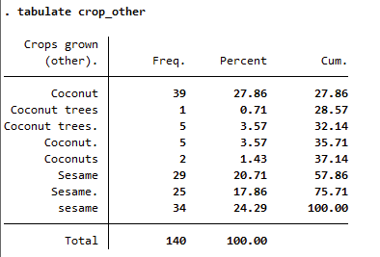
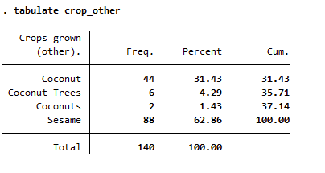
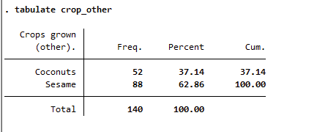
Cleaning string variable
1. Before cleaning string variable
2. After applying proper case, removing special characters, and removing extra spaces
3. Clean version

Slide 26
Encode variables
Each statistical software has optimized the formats it uses to store and handle different types if information
The clean dataset should contain no string variables, except for
Proper nouns that are not categories
Digits with leading zeros or long IDs (over 15 digits)
That means categorical string variables must be transformed into labeled variables or factors
The process of transforming text variables into categorical variables in Stata is called “encoding”.

Slide 27
Task 4: Identify categorical string variables
How do you tell categorical variables from text variables when they don’t yet have value labels?
Use ds, has(type string) to get a list of string variables
Use codebook [varlist], compact to check the number of unique values of these variables
Are there any variables with low number of unique values?
Use tabulate to get a frequency table of these variables

Slide 28
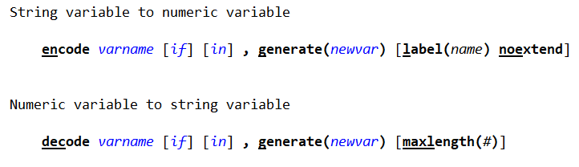
Encode variables in Stata
Note that there is a required option called generate()
This option will create a new variable with the encoded version of the original one

Slide 29
Task 5: Encode variables
encode the variable ar_farm_unit to create a new variable called ar_unit
Use labelbook to check how the values of the new variable ar_unit are defined

Slide 30
Missing values – Survey codes
During surveys missing answers are recorded using different codes. Like -8 8 or 88 for “I do not know” or -999 for “Declined to answer”
We need to turn these survey codes to missing values since -8 or -99 will distort averages and other calculations
Use any value of .a, .b etc. to represent “I do not know”, another one for “Declined to answer”, and another for each other missing answer code you have
Be consistent across your data set. If you pick .a for “Do not know” then use .a to represent that in all variables in your data set

Slide 31
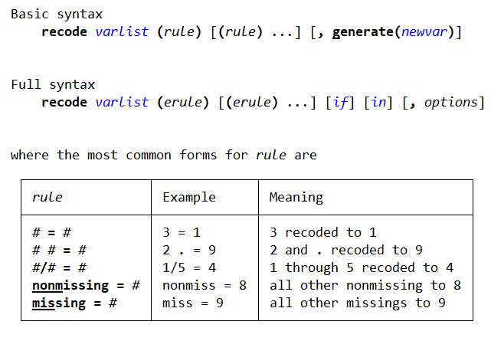
Recoding variables in Stata
recode changes the values of numeric variables according to the rules specified. Values that do not meet any of the conditions of the rules are left unchanged, unless an otherwise rule is specified

Slide 32
Task 6: Recode variables
Use summarize to spot variables that have negative values or binary variables which have values other than 0 and 1 (survey codes)
Use recode to replace the survey codes with extended missing values for these variables
-88 to .d (I don’t know)
88 to .d
recode varlist (# = .d)
summarize these variables again
What changed?
Check the minimum value
Check the number of observations

Slide 33
Task 7: Converting text to number
If a numeric variable was originally imported as a string variable, we can use the command destring to convert it into a numeric format
There are some numeric variables in our dataset that are stored as string variables. List all the string variables to identify which variables need to be converted to numeric variables
ds, has(type string)
The list has variables that should be numeric but are stored as string. Use destring to convert these to a numeric variables
destring [varlist], replace

Slide 34
Data Construction

Slide 35
What is Data Construction?
Construction transforms clean data into analysis data
This is done by creating derived variables:
Binary variables
Indices
Aggregated variables
Data construction also includes:
Combining datasets
Aggregating data sets

Slide 36
Constructing new variables

Slide 37
Create new numeric variables
Here are some simple mathematical operations that can be applied to numeric variables:
Addition | numvar1 + numvar2 or numvar + num
Subtraction | numvar1 - numvar2 or numvar - num
Multiplication | numvar1 * numvar2 or numvar * num
Division | numvar1 / numvar2 or numvar / num

Slide 38
Task 8: Construct numeric variables
Use the generate command to create the following new variables in the dataset:
area_acre: Farm area in acres (1 hectare = 2.47 acres)
livestock: A binary variable which is 1 if the household has any livestock now, 0 otherwise

Slide 39
Create new variables: egen
Apart from the generate command, there is another command that is very useful when creating new variables
It is called egen, or “extended generate”
There are a number of functions that will only work when used with egen
Check them out: help egen
This command is particularly useful when we want to aggregate information across rows without changing the level of observation in the data set

Slide 40
Task 9: Construct new variables
Use egen to create the following variables:
read: 1 if any of the two members can read, 0 otherwise
sick: 1 if any of the two members were sick in the last 4 weeks, 0 otherwise
total_treat_cost: total cost of treatment across two members

Slide 41
Outliers in datasets

Slide 42
Outliers
We do not want our results to be driven by a few individuals. For example, the village leaders get all benefits
No exact rule for what is an outlier.
Identifying outliers often comes down to common sense
Can the outlier be explained by typos? Especially common when selecting units from multiple choice lists
Useful commands:
sum, detail
tabulate
histogram
kdensity

Slide 43
Task 10: Identify Outliers
Use histogram and kdensity to visualize the distribution of the area_acre and food_cons
Are there outliers present?
Use summarize with the detail option to identify cutoff points for outlying values
What’s the cutoff?

Slide 44
Dealing with outliers
During cleaning exercise, we documented that some variables had outliers. We will now deal with them during construction.
How to deal with outliers?
This is ultimately the decision of the researcher
The goal is to deal with them while losing as little information as possible
Delete observations
Almost never desired as it loses a lot of information in variables that were correct
Delete specific data point (i.e., replace to missing)
Frequently used but the observation would be dropped in regressions using that variable
Winsorization is a method where observations are not dropped, neither from the data set or from regressions

Slide 45
Winsorization
This method assumes that an upper tail outlier is still some large number
We set all values greater than the 99th percentile to the 99th percentile
The outliers will still be large numbers, but it will no longer greatly bias the estimators
Can be applied to both upper and lower tail
Can be set to limits other than the 99th percentile
In Stata, the command to winsorize is winsor
winsor varname, p(#) gen(newvar) [ { highonly | lowonly } ]

Slide 46
Task 11: Winsorize
We identified some outliers in area_acre, food_cons
Use winsor to create a new variables area_acre_w, food_cons_w:
Winsorize at 95th percentile
Winsorize at upper tail

Slide 47
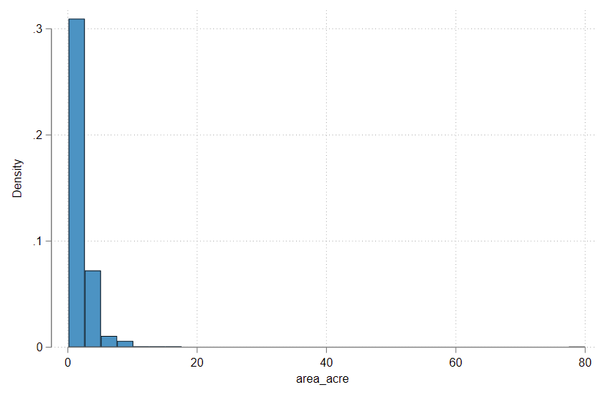
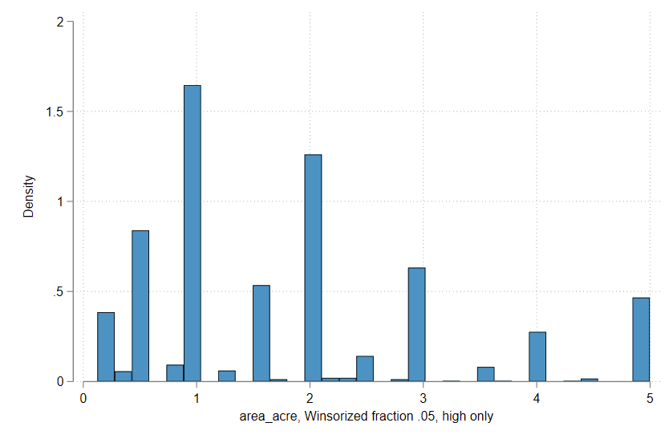
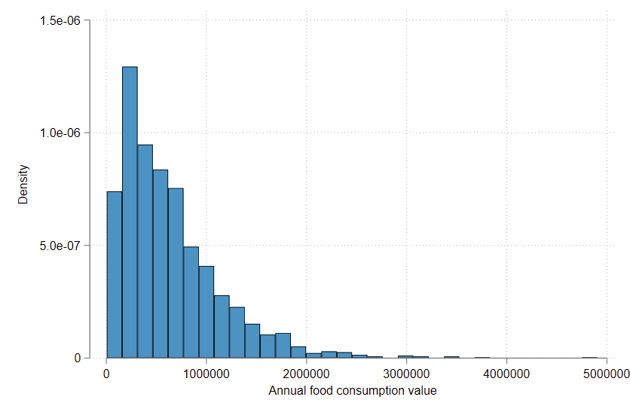
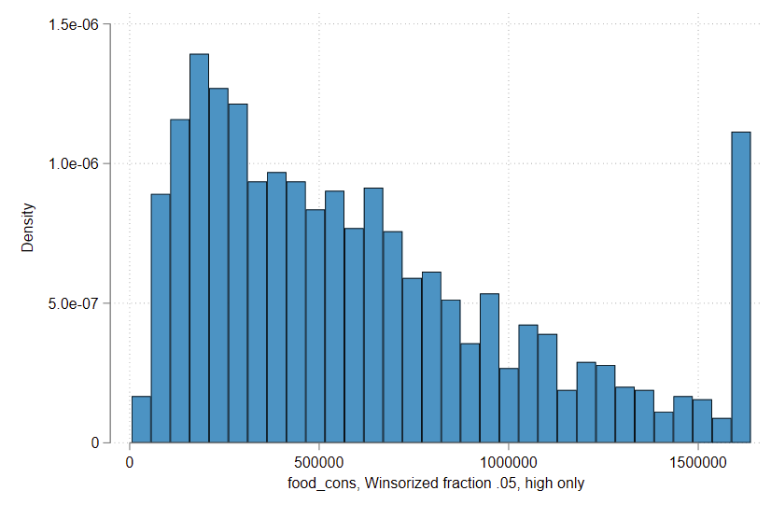
Winsorization
Before
After

Slide 48
Combining datasets

Slide 49
Combining datasets
All the construction operations we have seen so far are using a single data table
However, we often have separate data table that we need to combine to create our final indicators
There are two main ways of combining data tables:
Merging, when we combine data sets that contain more or less the same instances of the unit of observation, but different variables, to create a data set with more columns than the original ones
Appending, when we combine data sets that have more or less the same columns, but different instances of the unit of observation to increase the number of observations
Can you think of cases when you would need to perform merges or appends?

Slide 50
Combining datasets
All the construction operations we have seen so far are using a single data table
However, we often have separate data table that we need to combine to create our final indicators
There are two main ways of combining data tables:
Merging
Appending
when we combine data sets that contain more or less the same instances of the unit of observation, but different variables,
to create a data set with more columns than the original ones
when we combine data sets that have more or less the same columns, but different instances of the unit of observation
to increase the number of observations

Slide 51
Combining datasets
Examples of when merge is needed include:
Combining data on ID variable from a different dataset
Including location information
Examples of when append is needed include:
Combining data from different years
Combining data from different countries

Slide 52
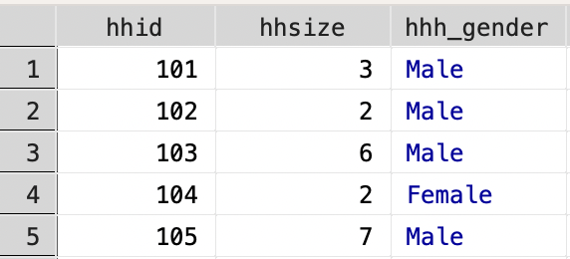
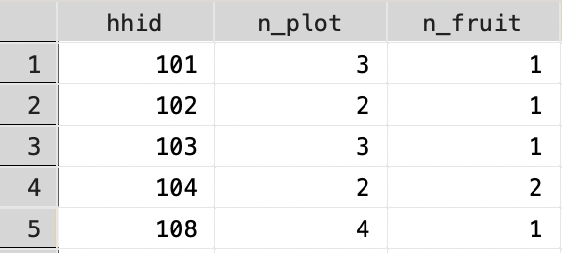
Combining datasets: merge
Dataset in memory: HH roster
Using dataset : Plot roster

Slide 53
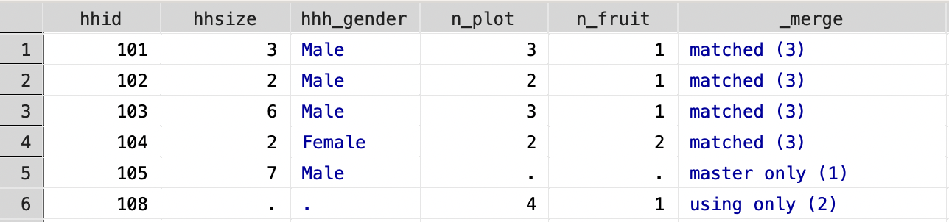
Combining datasets: merge
Master dataset
Using dataset : Plot roster
merge 1:1 hhid using agri_data.dta

Slide 54
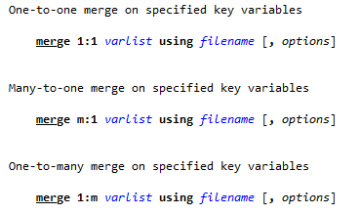
Combining datasets: merge
It only makes sense to merge two data sets that have common observations
The syntax of the command makes it clear that when merging two data sets, they need to have at least one variable in common
This is one of the points in the data work where having uniquely identifying variables is extremely important!
When merging two data sets, we first need to load one of them in memory (this will be called the master data), and then refer to the other one (the using data set) by its filename

Slide 55
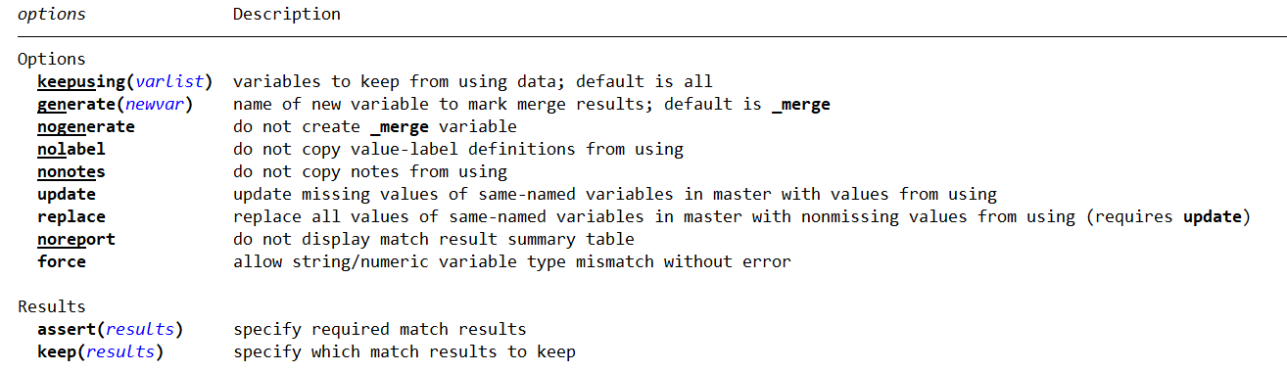
Combining datasets: merge
There are different options that allow you to test that the result of the merge matches your expectations:

Slide 56
Task 12: Merge datasets
Use merge to merge treat_status.dta to the current dataset
Which variable are you going to use to merge?
Will this be a one-to-one merge (merge 1:1) or many-to-one merge (merge m:1)?
Are all the observations merging?

Slide 57
Labels in Stata

Slide 58
Labels in Stata
When cleaning a data set you should also make sure that all variables are properly labeled
Check all variables have variable labels (in English or the language used in the research team)
Check all that all categorical variables have value labels (in English or the language used in the research team)
Useful commands:
label variable | Labels the variable
label define | Defines value label
label value | Assigns value label to variable
label dir | Lists names of value labels

Slide 59
Task 13A: Label variables and values
Use describe to check if all the variables have labels
Are there any variables without labels?
Label the variables that don’t have labels:
label variable varname “varlabel”
Are there any categorical variable without value labels?

Slide 60
Task 13B: Value labels
Are there any variables without value labels?
Can you assign an existing value label to these new variables?
Use an existing variable to assign values
label value varlist labelname
Define a new value label for treatment status so that it is 1 for treatment and 0 for control
label define lblname # "label" # "label«
Assign this label to the treatment variable
Use tabulate or browse to check how the categories are being displayed now

Slide 61
Ordering and Saving your work

Slide 62
Ordering variables
It is recommended the variables in the final data tables follow the same order as in the questionnaire
If the data was not collected exclusively for you study, you may want to group related variables, so they are close to each other
The variables that identify observations should be ordered first in each data table
Useful commands:
order varlist
order varlist, before()
order varlist, after()

Slide 63
Task 14: Saving your work
Before saving, make sure to drop any variables that were replaced or created to help clean the data
Make sure all the variables have labels
Save the dataset you’ve been working on to Final and call it TZA_CCT_baseline_clean
Save your do-file with any changes you have made

Slide 64
Aggregating observations

Slide 65
Aggregating observations
We have seen how egen allows us to aggregate information across rows
We can also use egen to aggregate information by group without changing the unit of observation of the data set
Sometimes, however, we do want to change the unit of observation
In these cases, we will use the command collapse
There are a number of different statistics that can be used with collapse:
mean, median, sd, sum, count, min, max
You can use the by(varlist) option to specify groups over which stat is to be calculated

Slide 66
Task 15: Aggregate observations
Use collapse to create a village level dataset that has the following variables:
Average food consumption value and area cultivated in acres
Total number of households in the village
Total members in the village
Treatment and District
Check if the aggregated data is unique in vid

Slide 67
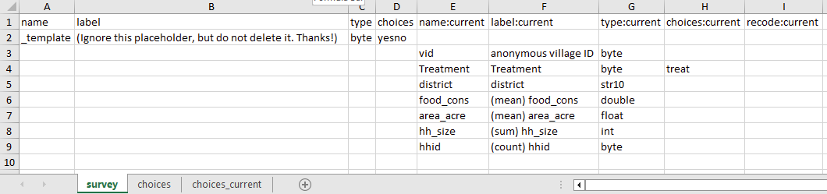
Annotating data using iecodebook
iecodebook is one of the commands inside iefieldkit
It simplifies the process of labeling variables and values in Stata by taking an Excel sheet as input

Slide 68
Annotating data using iecodebook
Rename variables
here
Add/Change variable labels here
Recode
here
Define new value labels here
Add/Change value labels here

Slide 69
Task 16: Use iecodebook
1. Use iecodebook template to list all the variables in the data
iecodebook template using “filepath/codebook.xlsx“
2. Open the spreadsheet created and complete the columns to rename and label variables
3. Use iecodebook apply to apply the indicated changes to the data
iecodebook apply using “filepath/codebook.xlsx“
4. Save the dataset

Slide 70
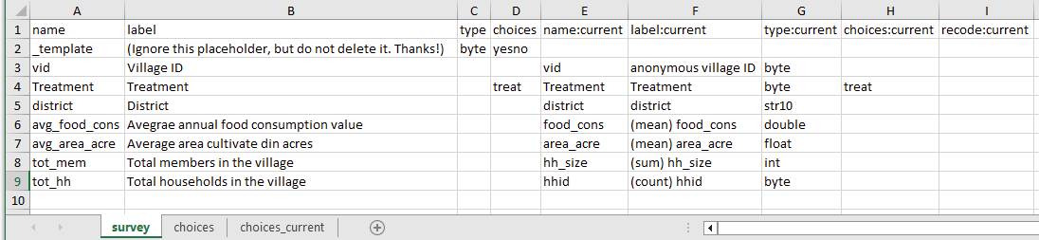
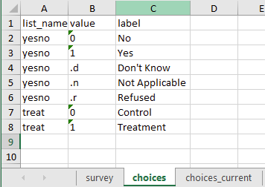
Use iecodebook
Rename, label, and add value labels
Add value labels in the “choices” sheets

Slide 71
Recap
We have learned:
How the identify unique ids and solve duplicates
Cleaning different types of variables
Constructing new variables
Identifying and dealing with outliers
Combining datasets
Labeling
Aggregating data
Using iecodebook

Slide 72
Thank you!

Slide 73
Further Reading
https://dimewiki.worldbank.org/Data_Cleaning
https://dimewiki.worldbank.org/Checklist:_Data_Cleaning
Data processing Stata cheat sheet

Slide 74
Appendix
iefieldkit

Slide 75
Stata package: iefieldkit

Slide 76
iecorrect
Modify data points in a dataset using an external human-readable changelog (spreadsheet) and maintain non-code documentation for all manual data point edits

Slide 77
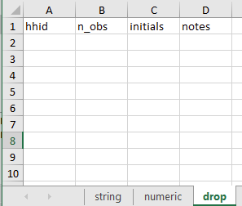
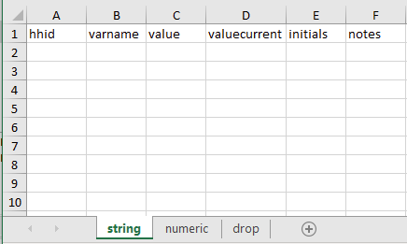
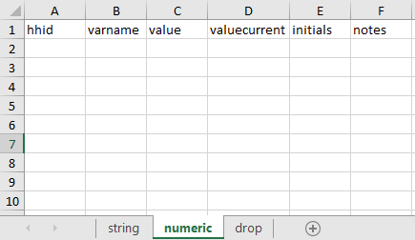
How does it work?
iecorrect template using "/path/to/corrections/file.xlsx", idvar(varlist)
For corrections in numeric variables
For corrections in string variables
For dropping observations

Slide 78
Task 17: Use iecorrect
Let’s assume during backchecks, the field team encountered some errors in the household survey, and you need to make some corrections. Use iecorrect to make the following corrections in the raw data:
For hhid 7110, the household size is 15
For hhid 9120 the other crop is Coconuts
1. Use iecorrect template to create the template
iecorrect template using “filepath/corrections.xlsx“, idvar(hhid)
2. Open the spreadsheet created and complete the columns to make correctionsin string and numeric sheets
3. Use iecorrect apply to apply the indicated corrections to the data
iecorrect apply using “filepath/codebook.xlsx“, idvar(hhid)

Slide 79
Appendix
Tidying dataset

Slide 80
Tidying Dataset
Adjusting the format of a dataset (the relationship between rows and columns) so that the resulting data can be more easily handled by statistical software
A tabular dataset is tidy when
Each column corresponds to one variable;
Each row corresponds to one observation; and
All variables in a data table have the same unit of observation.
Every other format is “untidy”.

Slide 81
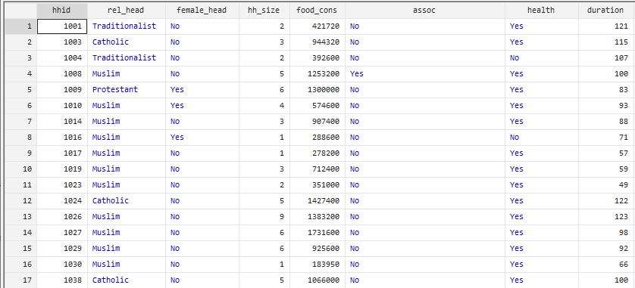
A data is tidy when
Each column corresponds to one variable
Each row corresponds to one observation
All variables in a data table have the same unit of observation.

Slide 82
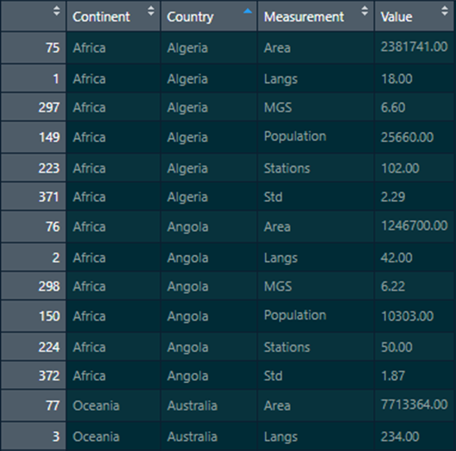


Is this data tidy?
There are multiple variables represented in a single column;
Each observation is separated into multiple rows.
All variables have the same unit of observation.
What would a tidy version of this data look like?

Slide 83
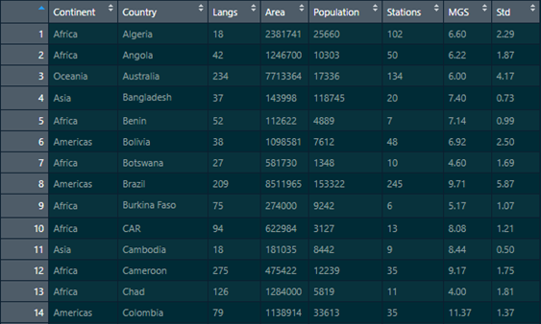
Tidy Data
Each column is a variable
Each row corresponds to an observation
All the variables have same unit of observation

Slide 84
Reshaping data
When all observations in a data table have the same unit of observation, reshaping is enough to make untidy data tidy
Reshaping: transforming the organization of rows and columns in a data table in such a way that each row represents an unit of observation
In Stata, this can be done using the reshape command

Slide 85
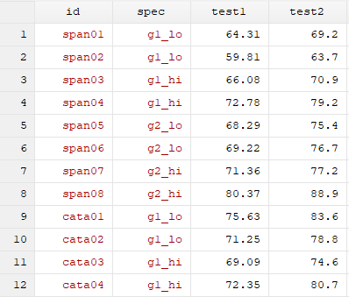
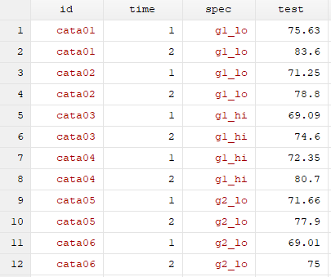
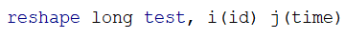
Reshaping data

Slide 86
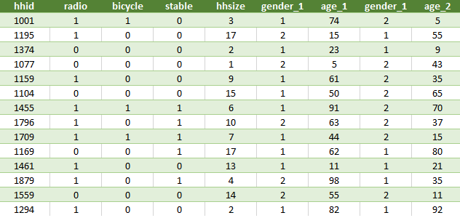
Is this data tidy?

Slide 87
Is this data tidy?
The variables in the data table have two different units of observation: household and household member
The age and gender variables are split into two columns
Each row contains multiple observations
What would a tidy version of this dataset look like?

Slide 88
Tidying data
When there are multiple units of observation in the same dataset, the process requires additional steps:
Identify all the variables that were measured at the same level of observation
Create separate tables for each level of observation
Reshape the data
At the end of this process, your dataset will consist of multiple data tables, one for each unit of observation
There are two additional components that are crucial to successfully managing a set of tidy tables:
Each table must be uniquely and fully identified by one or a set of ID variables
You must be able to use these ID variables to link all data tables to each other

Slide 89
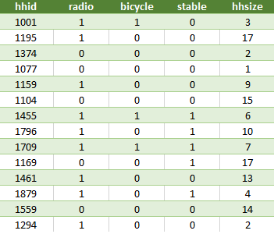
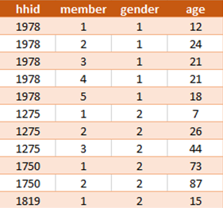
Tidy version
Household level dataset
Household-member level dataset

Slide 90
Tidy version
Each table is uniquely and fully identified by one or a set of ID variables
Can use these ID variables to link all data tables to each other

Slide 91
Setting the stage
Open a new do-file
Load the clean household dataset

Slide 92
Task 18A: Verify tidiness of data
Explore the data and verify whether the data is tidy or not?
Are all the observations being measured at the same level?
If not, what are the different levels of observations?
Can separate datasets for each level of observation be created?

Slide 93
Task 18B: Create Tidy data
Use reshape command to create a household-member level data
Make sure the data is unique at household-member level
Clean variable names using:
rename old_varname new_varname
Save the dataset

Slide 94
Appendix
Additional commands and best practices

Slide 95
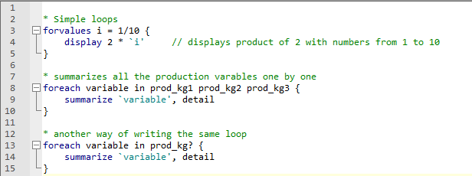
Loops: foreach and forvalue
Very often you will want to do the same thing over and over again. This is called “looping”.
Many times, you will want to change what is done in a predictable fashion. This is usually called “looping over” something.
foreach is a more general loop. String, numeric, and variables are allowed as list, and lists do not have to have a pattern.
forvalues is a more specific loop. Only numeric is allowed as lists, and lists should have a clear pattern
Setting up loops: use a meaningful `index’ local name
Foreach replace `index’ with the list items, in order
Variable names
Elements of a local
Whatever you want
Be careful about hierarchy/indentation

Slide 96
Task 19: Bulk recode
Recode all numeric variables that have survey codes with extended missing values:
Use ds, has(type numeric) to display a list of numeric variables in the data
Save this list in a local called numvars
local numvars `r(varlist)’
r(varlist) stored the list of numeric variables after the ds command
Using foreach, loop over the variables saved in the local to recode the survey codes to extended missing values
foreach nvar of local numvars {
recode ` nvar’ (# = .r) /// refused to answer
(# = .d) /// don't know
(# = .o) // other
}
summarize these variables again

Slide 97
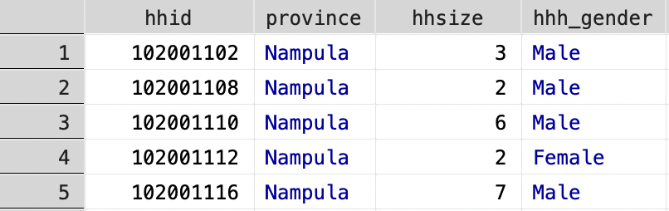
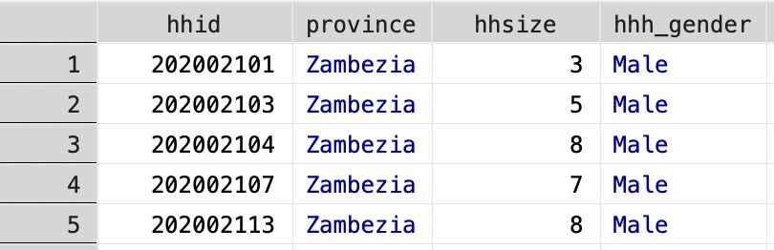
Combining datasets: append

Slide 98
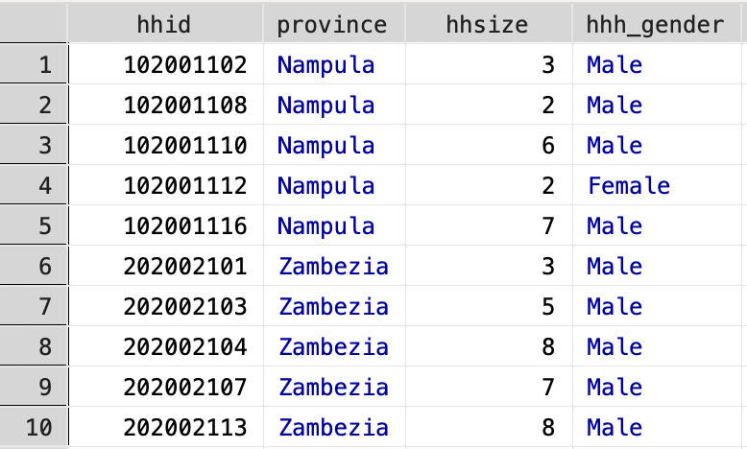
Combining datasets: append

Slide 99
Combining datasets: append
Stata can only have one data set in memory at once, so we need to call data sets saved as .dta (or as temporary files, but that is a more advanced topic)
append will add the observations in the using data set (the one referred to by its file name) to the master data set (the one that is currently loaded in the memory)
When a variable is present in only one of the datasets, its values will be missing for all observations that came from the data set that did not include it
If columns with the same name have different types of variables in the two data sets (for example, one is a string and one is numeric), this will cause the append to fail
You can use the option gen(newvar) to include a new variable indicating from which data set each observation came
Note that it only makes sense to append data sets that have the same unit of observation, but different instances of that unit of observation

Slide 100
Saving your work: Naming conventions
Make sure all output files, datasets and others are clearly and uniquely named
It’s often desirable to have the names of your data sets and do-files linked, so it is easy to understand which do-files is creating which data set, such as “merge.do” and “merged.dta” or “cleaning.do” and “clean.dta”
Do not use _v1, _v2 etc. for any final files. This leads to bugs in do-files that depend on these files when a new versions is added.
It’s ok to use _v1, _v2 etc. for old versions of files if you really need to keep an archive

Slide 101
Aggregating datasets: Best practices
Check and double-check the value assignments of questions, as well as their scales, before constructing new variables based on them
Look at the distributions of both the original and the constructed variables to make sure there is nothing unexpected happening in your data
Be mindful of how missing values are treated
The stat sum in the collapse command treats missing values as zero. If you are adding multiple missing values, it will return zero.

Slide 102
Output: Documentation
A few pieces of documentation should accompany the clean dataset:
A variable dictionary/codebook listing details about each variable
A description of how the data was collected
A complete record of any corrections made to the raw data, including careful explanation about the decision-making process involved
A report documenting any irregularities and distributional patterns (outliers) encountered in the data

